Slide 1
Merge Sort

Slide 2
Divide-and-conquer algorithms
Divide-and-conquer, breaks a problem into sub problems that are similar to the original problem, recursively solves the sub problems, and finally combines the solutions to the sub problems to solve the original problem.
Think of a divide-and-conquer algorithm as having three parts:
Divide the problem into a number of sub-problems that are smaller instances of the same problem.
Conquer the sub-problems by solving them recursively. If they are small enough, solve the sub-problems as base cases.
Combine the solutions to the sub-problems into the solution for the original problem.
Because we're using divide-and-conquer to sort, we need to decide what our sub problems are going to be.

Slide 3
Problem
Sub problem
divide
Sub problem
Solve
sub-problem
Conquer
Solve
sub-problem
Conquer
Solution
to
Sub-problem
Solution
to
Sub-problem
Combine
Solution to problem

Slide 4
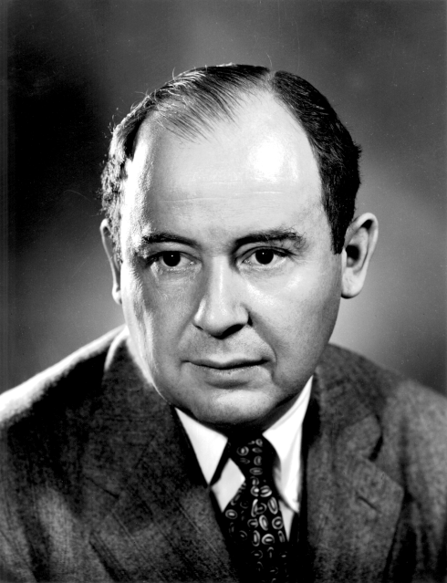
Merge sort algorithm
Merge sort is a sorting technique based on divide and conquer technique that was invented by John von Neumann in 1945.
Merge sort work on Two basic principle :
Sorting smaller list is faster than sorting larger list.
Combining two sorted sub lists is faster than
of two unsorted list.

Slide 5
Working of merge sort
Original Sequence
Sorted Sequence
18
26
32
6
43
15
9
1
1
6
9
15
18
26
32
43
18
26
32
6
43
15
9
1
18
26
32
6
6
18
26
32
6
18
26
32
9
1
9
1
15
18
26
32
6
15
43
43
15
9
1
43
43
15
9
1
18
26
1
9
18
26
43
1
9
18
26
6
6
32
15
32
6
32
15
43
18
26
32
6
9
1
43
15
9
1
43
15
26
15
26
32
9
43
15
9
1
18
32
6
1
18
6
43
18
32
6
43
9
1
18
26
32
6
43
15
9
1
26
15
18
26
32
6
43
1
18
32
6
43
15
9
26
15
9
1

Slide 6
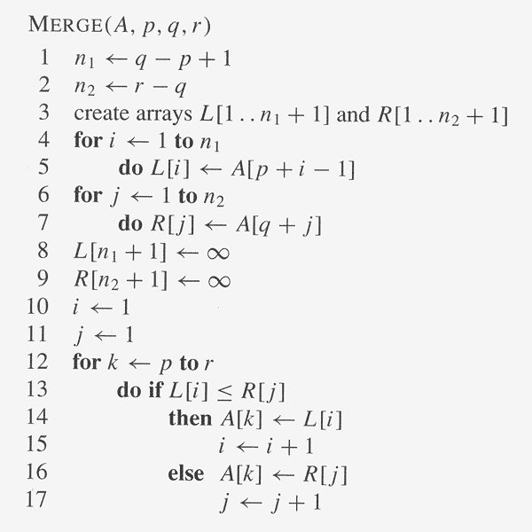
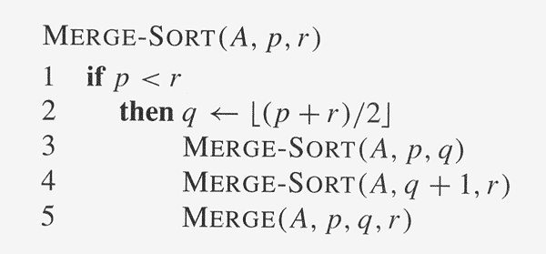
Algorithm for merge sort

Slide 7
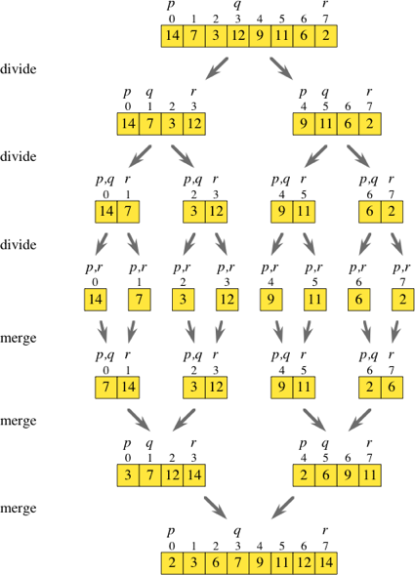
Example base on previous method to sorting the list using merge sort algorithm.

Slide 8
Weather list is already sorted , inverse sorted or randomly distributed , all three steps must be performed.
Merge sort cannot identify if list is sorted. So numbers of comparisons are same for 3 case.
Worst case of merge sort takes less time compared to insertion sort , selection sort & bubble sort .
However , best case of insertion sort (O(n)) beats all three cases of merge sort (O(nlog₂n))
Best case | Average case | Worst case
O(nlog₂n) | O(nlog₂n) | O(nlog₂n)

Slide 9
